Slide 1
MBTA Climate Change Strategy Overview
Presentation to MBTA Board of Directors May 26, 2022

Slide 2
Climate Change Strategy
How does the MBTA prepare for the impacts of extreme storms that will result from climate change?
What is the MBTA doing to address climate change by reducing its greenhouse gases?

Slide 3
Vulnerability Assessments for Future Climate Conditions
Vulnerability assessments are being completed for the entire rapid transit system, key bus and commuter rail facilities and other locations.
Facilities are being assessed for impacts from storm surge, flooding, wind, snow, ice and other conditions.
Assessing for forecasted climate conditions in 2030, 2050 and 2070.
Findings and recommendations embed into MBTA policies and programs (e.g., capital investment plan, transit asset management system, state of good repair, etc.) to institutionalize resiliency into infrastructure.
Working with OCE to develop design guidelines and design standards that address and include climate considerations
MBTA is working with stakeholders to share data & knowledge, develop policies, and work on regional protection projects that provide benefits to the MBTA’s system.
Working with the Climate Action teams in Boston, Cambridge, Somerville, and other municipalities we are located in.

Slide 4
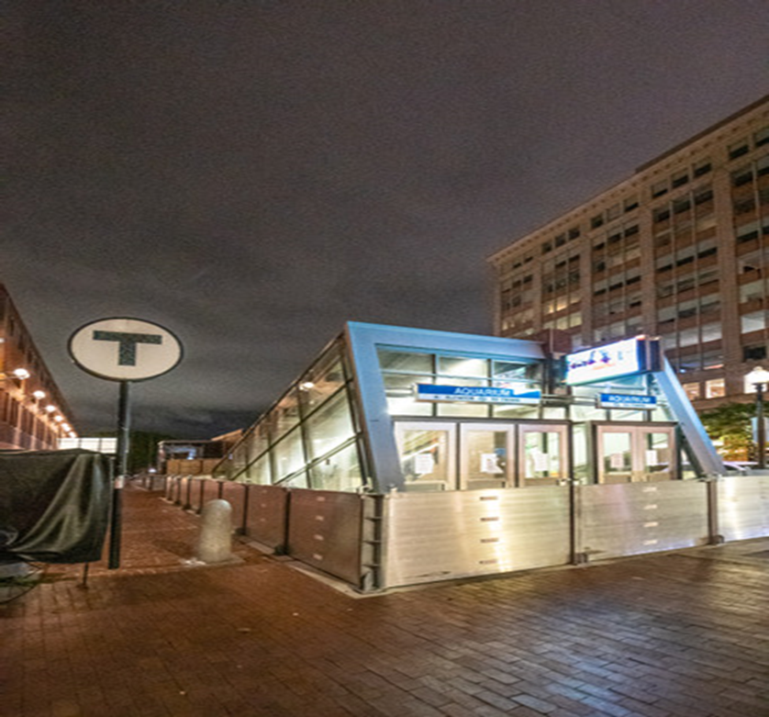
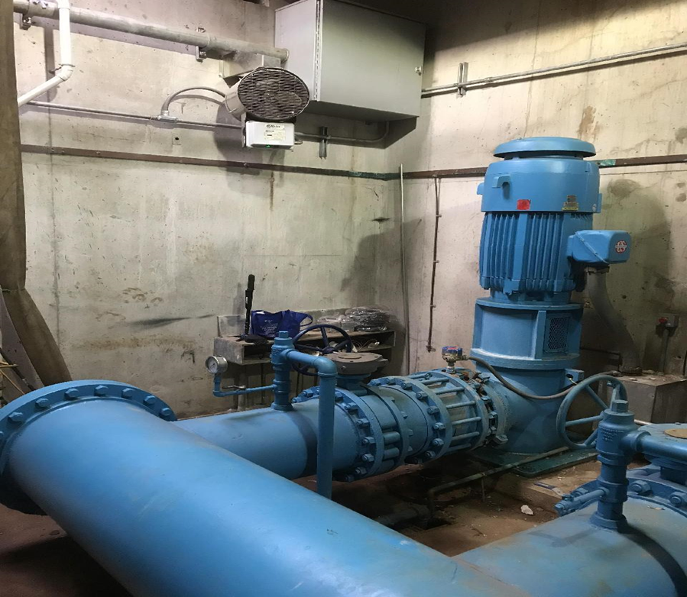
Status of Vulnerability Assessments for Future Climate Conditions
Rapid Transit Lines:
Blue Line – Completed
Red Line – Completed
Orange Line – Completed
Green Line – Spring 2022
Systemwide Assessments:
Power, Signal & Communications – Completed
Pump Stations – Completed
Bus Maintenance Facilities – Completed
Rapid Transit Vehicle Storage – Completed
Critical Facilities:
Cabot Yard – Summer 2022
Commuter Rail Facilities – Summer 2022
Commuter Rail:
Network assessment will begin in late 2022 to be completed in late 2023.
MIT Tunnel Study:
Developed a model of the MBTA tunnel network that projects where would flood and at what rate under various storm conditions.

Slide 5
Utilizing Real Time Storm Data to Locations Most at Risk
Real time storm mapping against MBTA assets initiated as part of the Storm Team.
The MBTA now maps the infrastructure against NWS mapping for storm elements such as:
Storm Surge
Extreme Winds
Rising River and Streams
Extreme Precipitation
Tornado Watches
Other storm elements as needed

Slide 6
Prioritize Resiliency in the Capital Plan
The Capital Investment Plan (CIP) project selection process prioritizes climate resiliency since it maintains and improves the overall reliability of the transportation system
Critical climate resiliency programs and projects currently in the CIP include:
Systemwide Tunnel Flood Mitigation Program
Blue Line Tunnel Improvements
Fiber Optic Burial Project
Courthouse Station Waterproofing Project
Pump Improvements

Slide 7
MBTA’s Greenhouse Gas Reduction Goals
Governor Baker’s Executive Order (“Leading By Example”) sets goals for state agencies to reduce its greenhouse gases associated with the burning of onsite fossil fuels at buildings and in vehicles:
20% in 2025
35% in 2030
60% in 2040
95% in 2050
Commonwealth also has an overall reduction goal of:
50% by 2030
100% by 2050

Slide 8
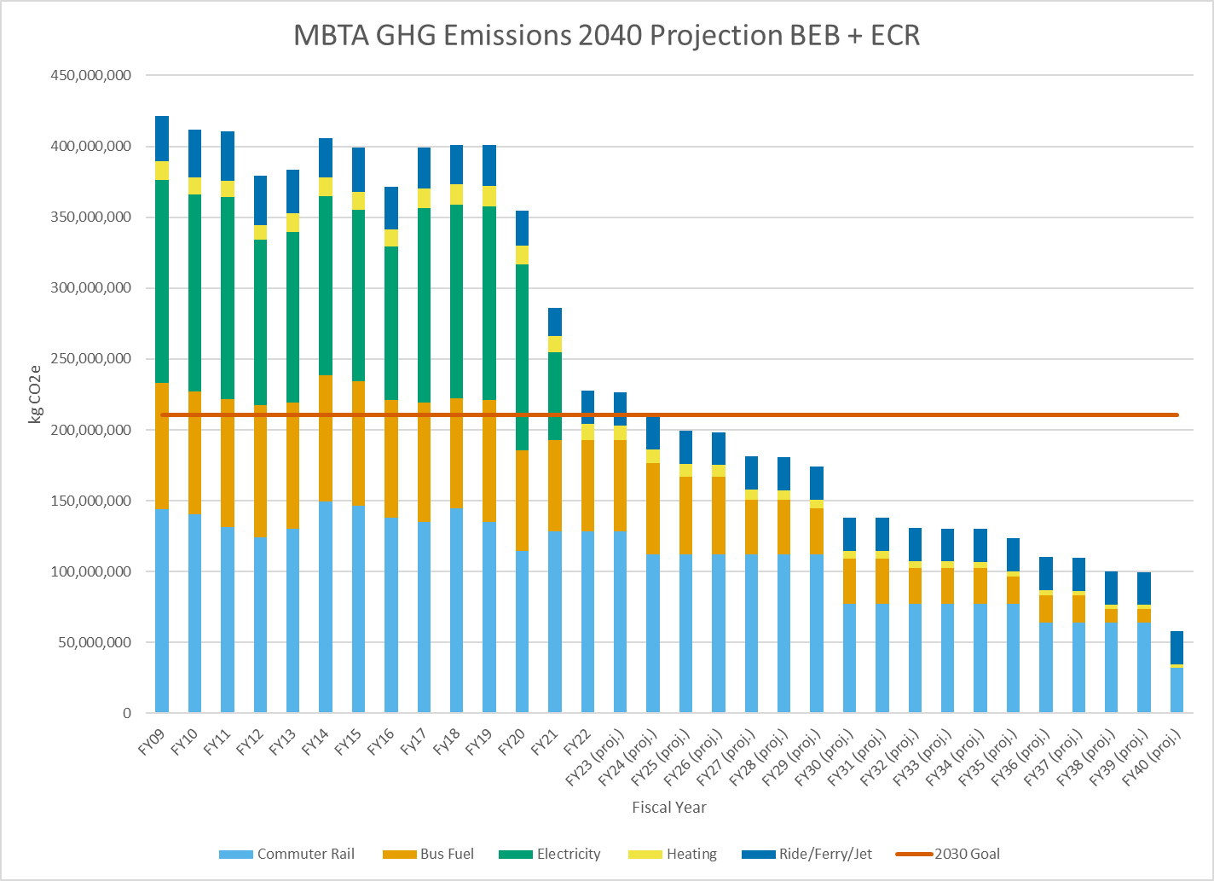
Annual System-wide Greenhouse Gas Emissions (kg CO₂-e) 2009 through 2040 (projected)
Progress as of June 2022
2030 Requirement

Slide 9
Bus Fleet and Facility Modernization Goals
Convert the entire bus fleet to Battery Electric Bus technology by 2040
Build new state of the art facilities to house and maintain new buses

Slide 10
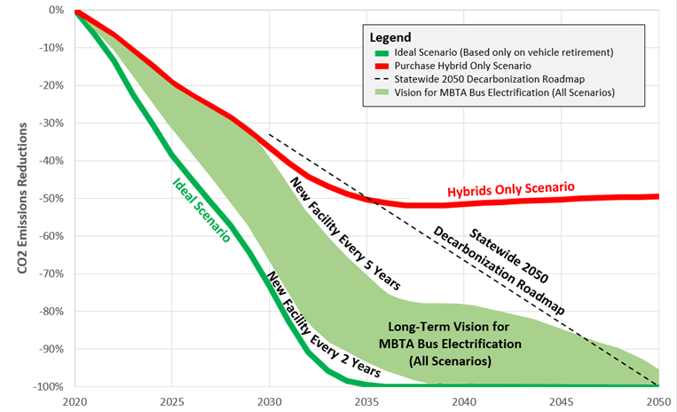
MBTA Bus Emissions Projections – Path to De-Carbonization

Slide 11
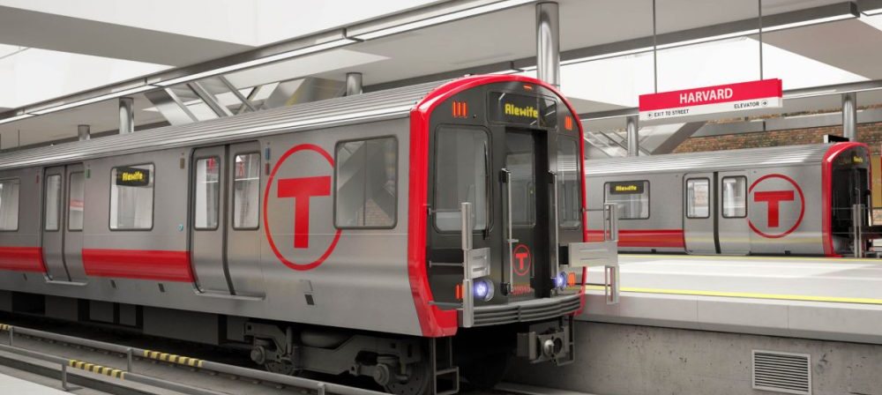
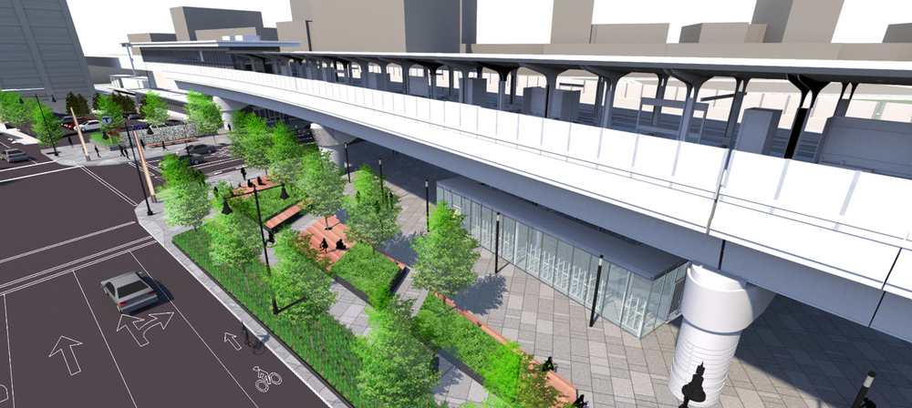
Energy Focus on Capital Projects & Asset Management
Incorporating sustainable and energy-focused elements into Capital Projects and Asset Management
Capital Delivery
New standards for lighting
Building control and energy management systems
High-efficiency systems
Asset Management
Focus on procurement of most efficient asset upgrades:
Compressors
HVAC Systems
Upgrades to more energy efficient fixtures
Tunnel Lighting Project

Slide 12
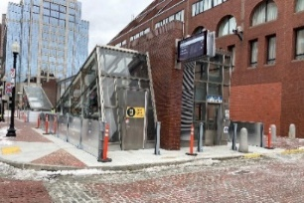
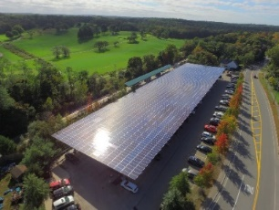
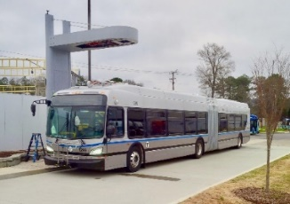
FY23-27 CIP | Sustainability & Resiliency (S&R) Spotlight
130+ sustainability & resiliency related projects - account for ~ $3.7B of programmed spending as part of the 5-year CIP. Incl. but is not limited to:
CIP Requests
Requests for projects are evaluated using 8 scoring criteria, which include resiliency under the system preservation, environmental and health effects criteria.
Key S&R Projects:
Rapid Transit
Fenway Portal Flood Protection (P0117)
Blue Line Flood Protection (P0582)
Bus
Procurement of 35 Battery Electric 40ft Buses and Related infrastructure (P0653)
Arborway Bus Facility Design Funding (P0671b)
Charlestown Seawall
Systemwide
Climate Change Resiliency Vulnerability Assessment (P0680)
Environmental Remediation and Compliance (P0435)
45 High Street Master Plan and Systems Resiliency (P0603)
Pump Improvements
Tunnel Flood Protection
40+ resiliency and vulnerability projects and assessments to curb climate change and environmental impacts systemwide
40+ projects related to assets, energy, waste management, and remediation to ensure efficiency and long-term sustainability and resiliency of service and facilities
35+ projects to procure, overhaul, and upgrade fleet and facilities for bus electrification, vehicle efficiency, and reduction of carbon footprint

